Slide 1
Rethinking Knee OA treatment in a Post-Pandemic World Short and Long Term Solutions

Slide 2
Learning Objectives:
Identify patient and treatment factors that predict a favorable response to HA
Differentiate between available intra-articular treatment options for OA Knee
Articulate newer clinical evidence on the use and efficacy of High Molecular weight HA
Deepen the understanding for hyaluronic acid’s (HA) placement in the treatment algorithm of knee OA
Highlight the Biological and possible disease modifying effects of HA
Discover insights regarding HA’s mechanism of action
Discover new disease modifying treatment options
Reassessing our treatment of OA Knee in the post COVID-19 Pandemic era

Slide 3
Why the controversy?
Are HAs the first true DMOAD?
Why have we got it wrong for so long?
Have we done the wrong research?
Which patients will benefit most from HAs?
Which patients actually get HAs?
Who actually sees the patients who will benefit most from HAs?
Are we promoting to the wrong customer base?
Why do we continue to treat the symptoms only?
Why are corticosteroids used repeatedly?
What’s the point of using Opiates?
Shouldn’t we be trying to delay the need for TKA?

Slide 4
Prospective Comparison of Sham vs. Placebo Injections: Data from a Trial of Lorecivivint (SM04690), a Wnt Pathway Inhibitor for Knee OA
Both groups showed clinically relevant improvements from baseline at first measurement that persisted through Week 24.
Subjects with knee OA receiving a single IA injection of PBO reported no differences in changes from baseline in knee OA PROs compared to subjects who received sham injections.
http://dx.doi.org/10.1136/annrheumdis-2019-eular.4454
Notes:
Saltzman BM, Leroux T, Meyer MA, et al. The Therapeutic Effect of Intra-articular Normal Saline Injections for Knee Osteoarthritis: A Meta-analysis of Evidence Level 1 Studies. Am J Sports Med. 2017;45(11):2647‐2653. doi:10.1177/0363546516680607
Background: Intra-articular normal saline (IA-NS) injections have been utilized as a placebo in a number of randomized controlled trials pertaining to the management of knee osteoarthritis (OA); however, it is believed that these "placebo" injections may have a therapeutic effect that has not been quantified in the literature.
Purpose: To (1) quantify the effect of IA-NS injections on patient-reported outcomes (PROs) and (2) compare postinjection PROs to established minimal clinically important difference (MCID) criteria to demonstrate a potential therapeutic effect.
Study design: Meta-analysis.
Methods: A review was conducted to identify all randomized, placebo-controlled trials on injection therapy for knee OA between 2006 and 2016. Patient demographics and PROs before the injection and at 3 and 6 months after the injection were collected for patients in the IA-NS injection group in each study. A random-effects model was used to compare preinjection scores and scores at each postinjection time point in a pairwise fashion.
Results: In total, there were 14 placebo cohorts in 13 studies that were analyzed after meeting inclusion criteria for this meta-analysis. This included 1076 patients (Kellgren-Lawrence grade 1-4), with a weighted mean age of 62.53 years and mean body mass index of 28.67 kg/m². There was only sufficient information to perform analyses of visual analog scale (VAS) pain and Western Ontario and McMaster Universities Arthritis Index (WOMAC) total scores. At 3 months after the IA-NS placebo injection, there was a significant improvement in VAS pain scores (mean difference [MD], 12.10 [95% CI, 3.27 to 20.93]; P = .007), whereas improvement in the WOMAC total scores approached but did not reach statistical significance (MD, 19.75 [95% CI, -0.50 to 40.09]; P = .06). At 6 months, both VAS pain scores (MD, 16.62 [95% CI, 12.13-21.10]; P < .00001) and WOMAC total scores (MD, 11.34 [95% CI, 7.03-15.65]; P < .00001) were significantly improved in comparison to preinjection values. Furthermore, improvements in both the VAS pain and WOMAC total scores at 6 months were clinically significant (MCID, 1.37 and 9, respectively).
Conclusion: The administration of an IA-NS placebo injection yields a statistically and clinically meaningful improvement in PROs up to 6 months after the injection in patients with knee OA. This observation supports the notion that the so-called placebo effect for IA-NS injections achieves a clinically meaningful response in patients with OA when provided during comparison studies to an active treatment group (ie, hyaluronic acid).

Slide 5
Clinical Management of OA Knee Pain
Non-pharmacologic¹
^{Education,} ^{Exercise, Weight Loss,}
^{Bracing, Physical Therapy}
Mild/Moderate Pain²
Moderate/Severe Pain²
Intra-articular steroids
Intra-articular hyaluronic acid (HA)
PRP, MSC
Simple analgesics
Topical analgesics
COX-2 inhibitors
NSAIDs
w/wo gastro-protection
Surgical Interventions³
Arthroscopic debridement
Cartilage repair
Osteotomy
Unicompartmental or total knee arthroplasty
Zhang W, et al. Osteoarthritis Cartilage. 2010;18:476-499.
Figure adapted from Moskowitz RW. Curr Rheumatol Rep. 2000;2(6):466-471
Ronn K, et al. Arthritis. 2011;2011:454873.
COX-2=cyclooxygenase
NSAIDs=non-steroidal anti-inflammatory drugs.

Slide 6
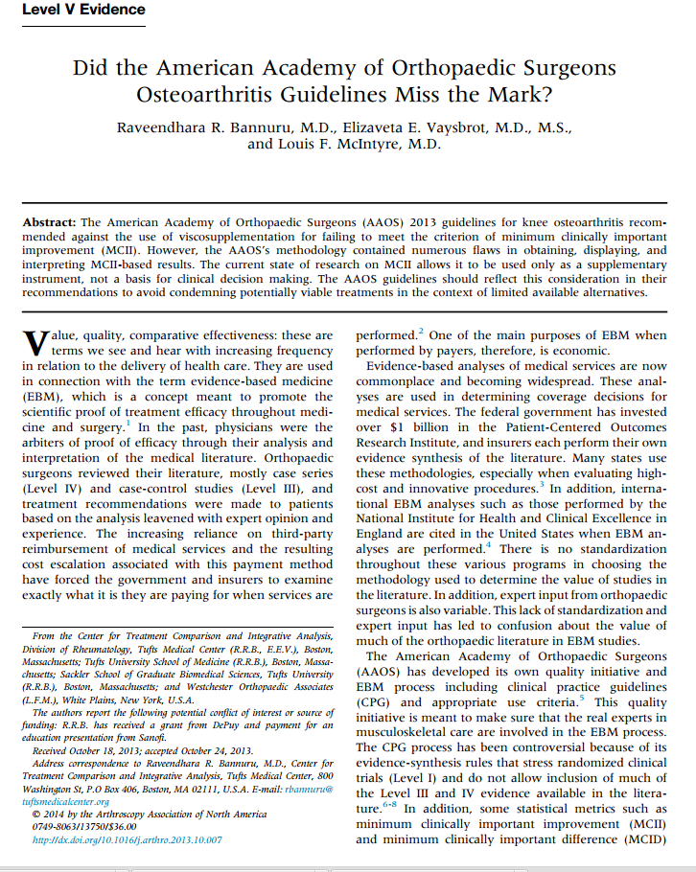
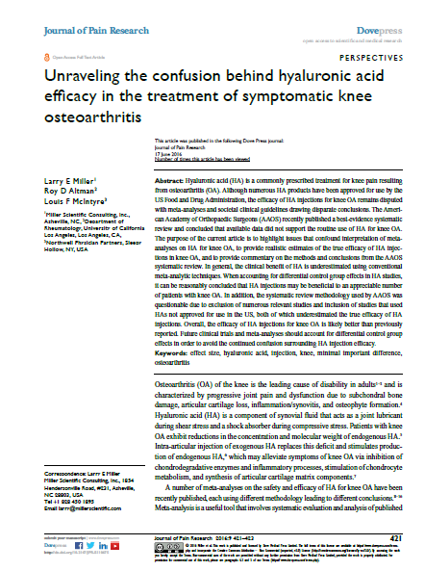
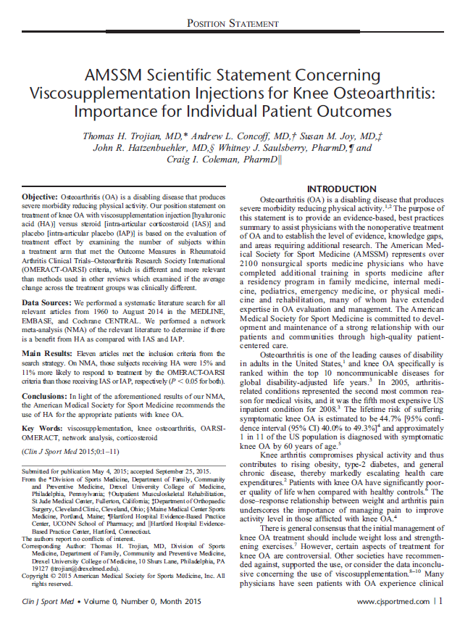
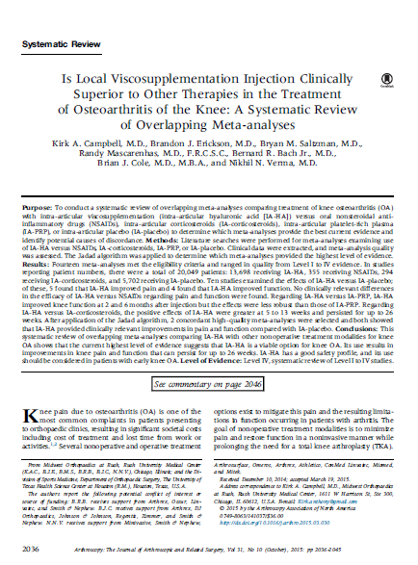
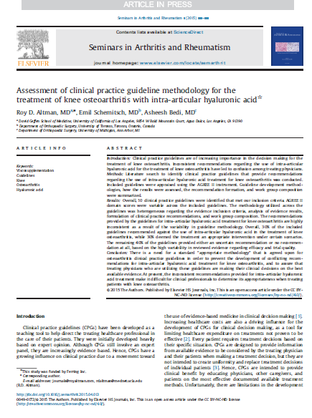
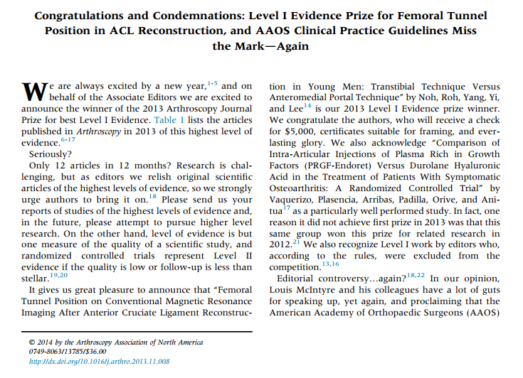
The Aftermath of the AAOS CPG in 2013
Notes:
Since the release of the 2013 AAOS guidelines, several peer-reviewed publications have challenged the methodology utilized:
Bannuru, et al. (2013)
Challenged MCII methodology, and demonstrated NMA more appropriate
Lubowitz, et al. (2014)
Challenged MCII methodology
Trojian, et al. (2014)
Challenged MCII methodology and demonstrated NMA and OMERACT/OARSI criteria more appropriate
Altman, et al. (2015)
Challenged MCII methodology
Campbell, et al. (2015)
Challenged MCII methodology
Miller, et al. (2016)
Challenged MCII methodology
MCII = Minimal clinical importance difference;
NMA = Network meta-analysis;
OMERACT/OARSI = Outcome Measures in Rheumatoid Arthritis Clinical Trials; Osteoarthritis Research Society International.

Slide 7
Health Care Recommendations on Injectable Treatments for Knee OA: An International Perspective
International guidelines 2003-2020
Search identified 27 guidelines that provided a recommendation on the use of injectables for OA Knee
 | # of Guidelines with Recommendations | Strong Recommendation Against | Conditional Recommendation Against | Conditional Recommendation For | Strong Recommendation For
IACS | 24 (89%) | 1 | - | 11 | 10
IAHA | 27 (100%)* | 3 | 2 | 10 | 10
PRP | 12 (44%)¤ | 2 | - | - | -
* 2 Uncertain recommendations
¤ 10 Uncertain or unable to make a recommendation
IACS – Intra-Articular CorticoSteroids
IAHA – Intra-Articular Hyaluronic Acid
PRP – Platelet Rich Plasma
Notes:
Why HA studies often fail!
Inappropriate patient population studied
K-L IV patients included
Effusions present at time of treatment
Polyarthropathy
Saline is NOT a placebo
VAS pain assessment very subjective
The most dangerous part of an HA injection is the person doing the injection. Most of the adverse event reports we get are due to injections that do not get into the joint space!
HA is probably the safest of all the treatment options especially when compared with other injections and long term NSAIDs or opiates.

Slide 8
Health Care Recommendations on IAHA for Knee OA
Data point size is weighted by number of repeat recommendations in the same year

Slide 9
The Osteoarthritis Initiative
The Osteoarthritis Initiative (OAI) is a multi-center, ten-year observational study of men and women, sponsored by the National Institutes of Health (part of the Department of Health and Human Services). The goals of the OAI are to provide resources to enable a better understanding of prevention and treatment of knee osteoarthritis, one of the most common causes of disability in adults.
https://nda.nih.gov/oai/

Slide 10
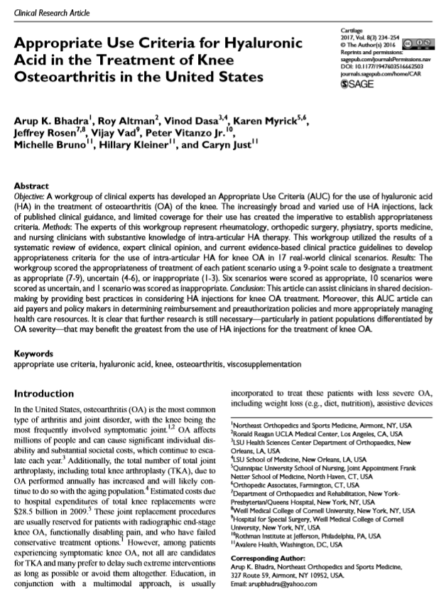
Appropriate use Criteria (2017)
Working Group of Clinical Experts
Most comprehensive assessment of Appropriate Use Criteria (AUC) for HA
Developed AUC for 17 different clinical scenarios
1 scenario - INAPPROPRIATE
10 scenarios - UNCERTAIN
6 scenarios – APPROPRIATE
NOT Industry sponsored
Notes:
Why is this not used by Payers to determine coverage of HA’s

Slide 11
Appropriate USE Criteria (AUC) - Mild OA
Symptomatic adults with mild osteoarthritis of the knee who have clinically and radiologically confirmed disease who have not received other therapies for the knee
Symptomatic adults with mild osteoarthritis of the knee who have clinically and radiologically confirmed disease and have failed other non-pharmacologic or pharmacologic therapies for the knee
Symptomatic adults with mild osteoarthritis of the knee who have clinically and radiologically confirmed disease who have incomplete response to other therapies for the knee

Slide 12
Appropriate USE Criteria (AUC) - Moderate OA
Symptomatic adults with moderate osteoarthritis of the knee who have clinically and radiologically confirmed disease who have not received other therapies for the knee
Symptomatic adults with moderate osteoarthritis of the knee who have clinically and radiologically confirmed disease and have failed other non-pharmacologic or pharmacologic therapies for the knee
Symptomatic adults with moderate osteoarthritis of the knee who have clinically and radiologically confirmed disease who have incomplete response to other therapies for the knee

Slide 13
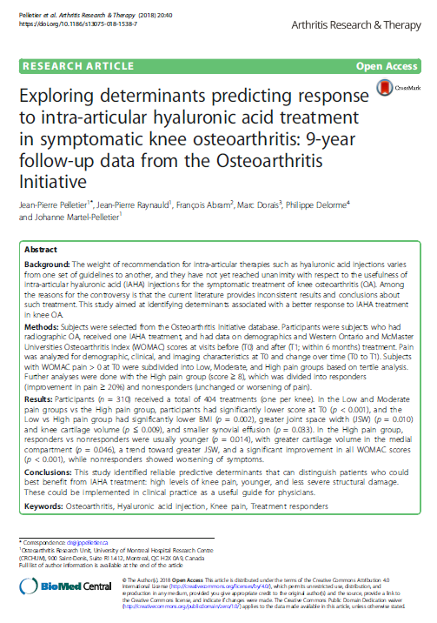
Predicting a Favorable Response to IAHA
Exploring Determinants Predicting Response to IA-HA in Symptomatic Knee OA
Subjects selected from the OAI with radiographic OA, received HA, and had outcomes data (WOMAC)
The study successfully allowed the identification of new reliable predictive factors that can identify patients who could best benefit from IAHA treatment.
Patients with:
Mild to moderate disease (K-L II-III)
Moderate to severe symptoms (Mostly pain)
Younger
Greater medial compartment cartilage volume (CV)
are the most likely to respond to treatment with the greatest level of improvement.
Pelletier JP, et. al. Determinants Predicting Response to Intra-Articular Hyaluronic Acid Treatment in Symptomatic Knee Osteoarthritis (2018)

Slide 14
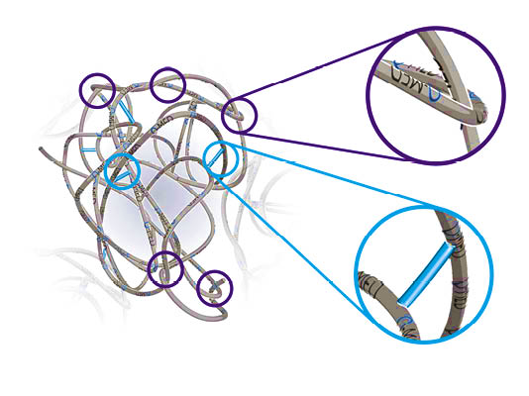
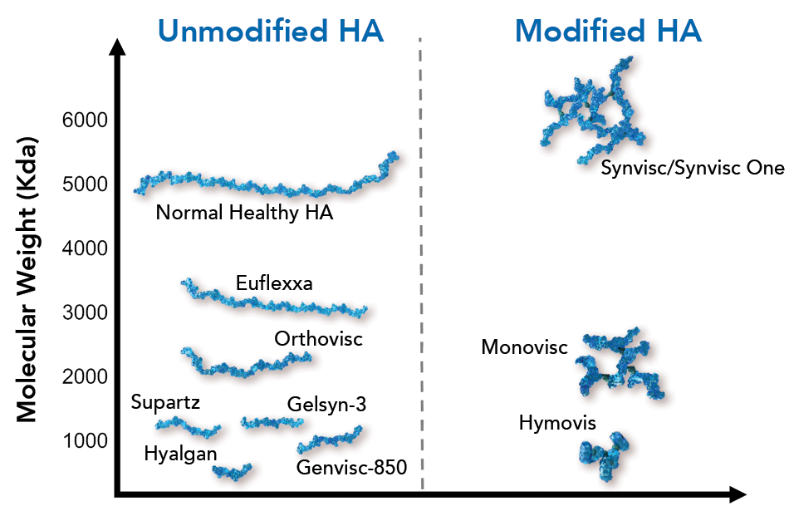
Not all HA’s are the same……..
Durolane®
Durolane®
*Gel-One: Modified, cross-linked HA. Molecular Wt. not reported
* Durolane®: NASHA Molecular Wt.10¹² Kda

Slide 15
Biological Effects of IAHA: MOA
Synthetic HA helps restore the mean median molecular weight of natural HA in the knee.
Higher Mol. Wt. HA provides a better profile of proteoglycan synthesis, joint lubrication and viscoelasticity than Low Mol. Wt. formulations.
HA in OA works in several ways:
Increases viscosity of articular fluid
Decreases oxidative stress
Inhibits phagocytosis
Reduces pain by inhibiting nociceptors by blocking stretch-activated mechanoreceptors
E. C. Rodríguez-Merchán, P. Gómez-Cardero (eds.), Comprehensive Treatment of Knee Osteoarthritis, May 2020
https://doi.org/10.1007/978-3-030-44492-1_3

Slide 16
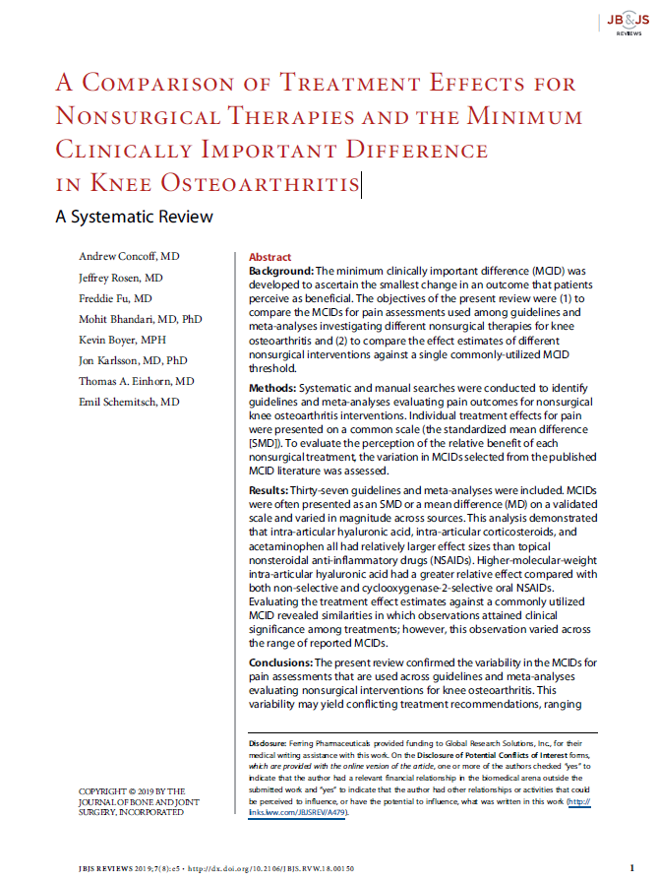
In Favor of High Molecular Weight HA
A Comparison of Treatment Effects for Nonsurgical Therapies and the Minimum Clinically Important Difference in Knee Osteoarthritis.
The objectives of the present review were to compare
The MCIDs for pain assessments used among guidelines and meta-analyses investigating different nonsurgical therapies for knee osteoarthritis
The effect estimates of different nonsurgical interventions against a single commonly-utilized MCID threshold.
This analysis demonstrated that intra-articular hyaluronic acid, intra-articular corticosteroids, and acetaminophen all had relatively larger effect sizes than topical nonsteroidal anti-inflammatory drugs (NSAIDs).
Higher-molecular-weight intra-articular hyaluronic acid had a greater relative effect compared with both non-selective and COX-2s NSAIDs.
Concoff et al. JBJS Rev. 2019 Aug;7(8):e5. doi: 10.2106/JBJS.RVW.18.00150

Slide 17
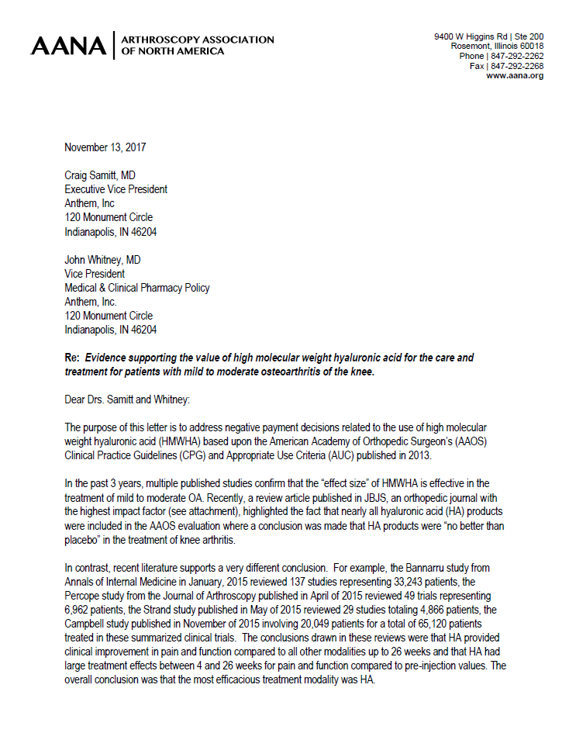
AANA Response to Anthem - 2017
The purpose of this letter was to address negative payment decisions related to the use of high molecular weight hyaluronic acid (HMWHA) based upon the American Academy of Orthopedic Surgeon’s (AAOS) Clinical Practice Guidelines (CPG) and Appropriate Use Criteria (AUC) published in 2013.
Multiple published studies confirm that the “effect size” of HMWHA is effective in the treatment of mild to moderate OA.
The conclusions drawn in these reviews were that
HA provided clinical improvement in pain and function compared to all other modalities up to 26 weeks
HA had larger treatment effects between 4 and 26 weeks for pain and function compared to pre-injection values.
The overall conclusion was that the most efficacious treatment modality was HMWHA.
Notes:
Unfortunately (some) payers do follow published guidelines when making decisions – in the hope that the body providing the guidance is doing so objectively and without bias!

Slide 18
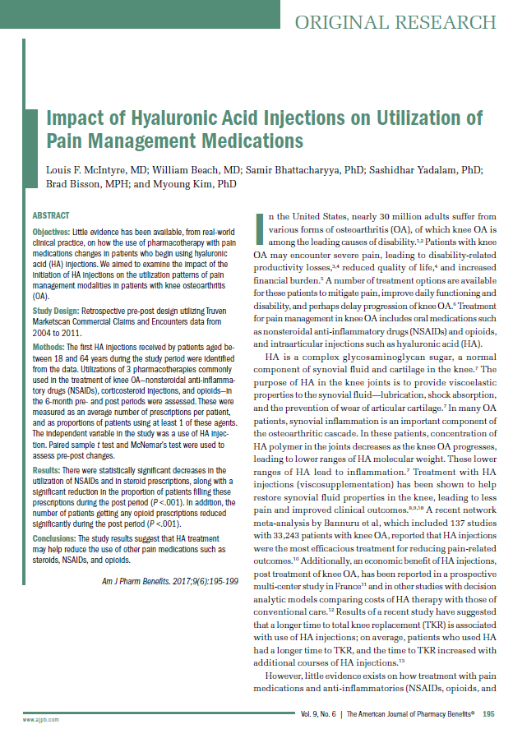
Impact of Hyaluronic Acid Injections on Utilization of Pain Management Medications
Retrospective pre-post design utilizing Truven Marketscan Commercial Claims and Encounters data from 2004 to 2011.
Utilizations of NSAIDs, IACS, and opioids in the 6-month pre- and post periods were assessed.
There were decreases in the utilization of NSAIDs and IACS during the post period (P <.001)
The number of patients getting any opioid prescriptions reduced significantly during the post period (P <.001)
Louis F. McIntyre, MD et. al. Am J Pharm Benefits. 2017;9(6):195-199

Slide 19
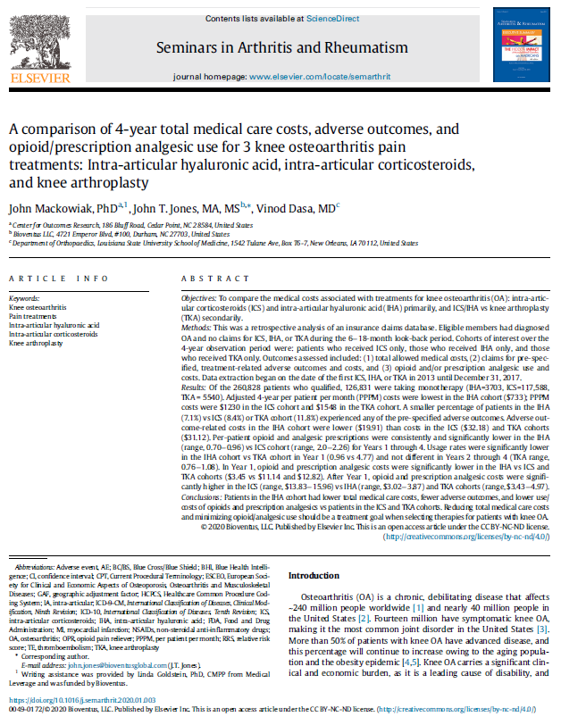
HASTE (Hyaluronic Acid versus STEroids)
A comparison of 4-year total medical care costs, adverse outcomes, and opioid/analgesic use for 3 knee osteoarthritis pain treatments: IAHA,IACS, and KA.
Adjusted costs for all care were lower in the HA only group versus the CS only and TKA/UKA only group
Proportionately fewer adverse events were documented in the HA group versus the CS or TKA/UKA only groups
Costs associated with adverse events were lower in the HA only group versus CS or TKA/UKA only
Opioid and painkiller use and cost of use was lower in the HA group versus the CS group
Mackowiak J, Jones JT, Dasa V, Seminars in Arthritis and Rheumatism
https://doi.org/10.1016/j.semarthrit.2020.01.003

Slide 20
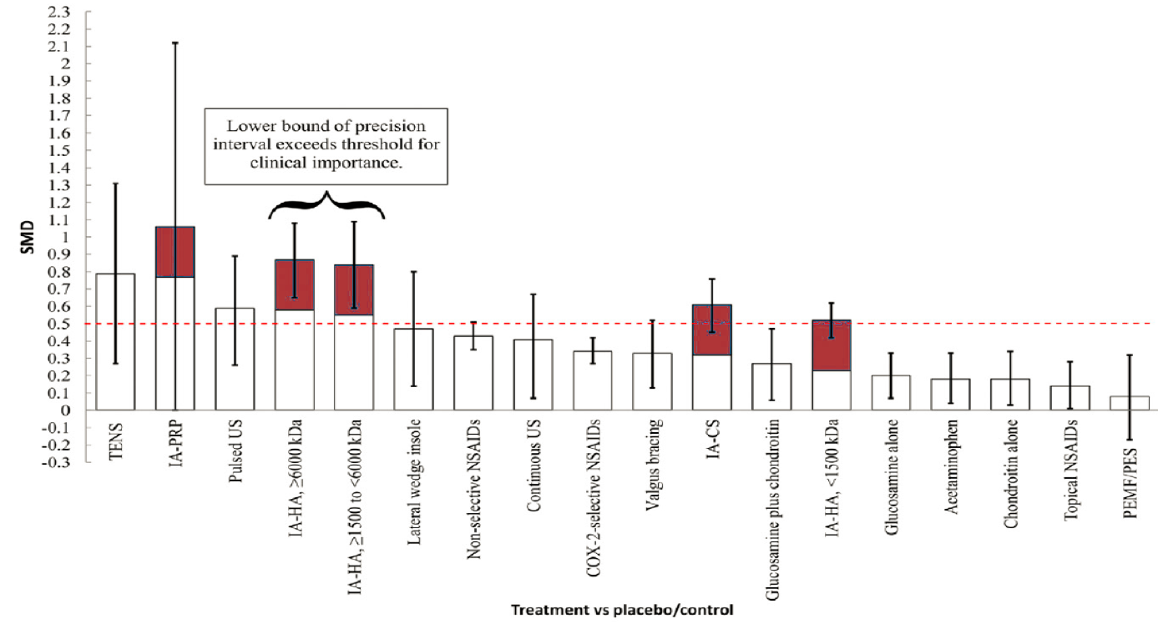
Non-operative Treatments for Knee Osteoarthritis: An Evaluation of Treatment Characteristics and the Intra-Articular Placebo Effect A Systematic Review
10 meta-analyses (sample range, 110-39,814) of nonoperative treatments for patients with knee OA
9 studies with effect sizes for pain were included
After accounting for the placebo effect, the largest effect sizes were for PRP and HA
HA had the most precise estimate that surpassed the threshold for clinical importance
Vannabouathong C, et al J Bone Joint Surg Rev 2018;6:e5.
Notes:
While many nonoperative treatments demonstrated significant improvements in pain, we found the greatest effect estimates for intra-articular treatments. While platelet-rich plasma provided the greatest point estimate of the treatment effect, variability among studies suggests that future research into optimal formulations is required. The strongest current evidence supports clinically important and significant treatment effects with intra-articular hyaluronic acid formulations between 1,500 and >6,000 kDa.

Slide 21
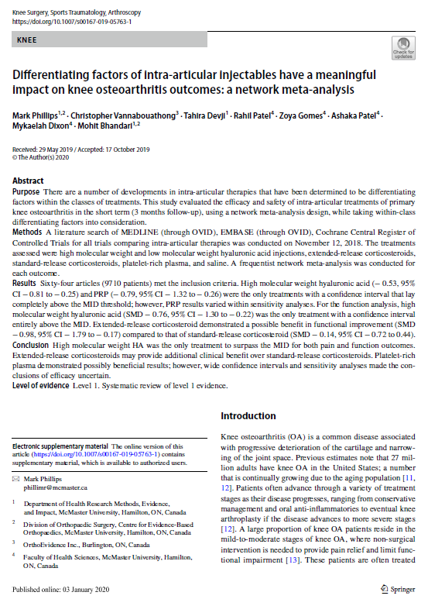
Differentiating Factors of IA injectables
Purpose: This study evaluated the efficacy and safety of intra-articular treatments of primary knee osteoarthritis in the short term (3 months follow-up), using a network meta-analysis design.
Results: Sixty-four articles (9710 patients) met the inclusion criteria.
Conclusions:
High molecular weight HA was the only treatment to surpass the MID for both pain and function outcomes.
Extended-release corticosteroids may provide additional clinical benefit over standard-release corticosteroids.
Platelet-rich plasma demonstrated possibly beneficial results; however, wide confidence intervals and sensitivity analyses made the conclusions of efficacy uncertain.
Level of evidence: Level 1. Systematic review of level 1 evidence.
Knee Surgery, Sports Traumatology, Arthroscopy
https://doi.org/10.1007/s00167-019-05763-1
Notes:
Methods: A literature search of MEDLINE (through OVID), EMBASE (through OVID), Cochrane Central Register of Controlled Trials for all trials comparing intra-articular therapies.
High molecular weight hyaluronic acid (− 0.53, 95% CI − 0.81 to − 0.25) and PRP (− 0.79, 95% CI − 1.32 to − 0.26) were the only treatments with a confidence interval that lay completely above the MID threshold.

Slide 22
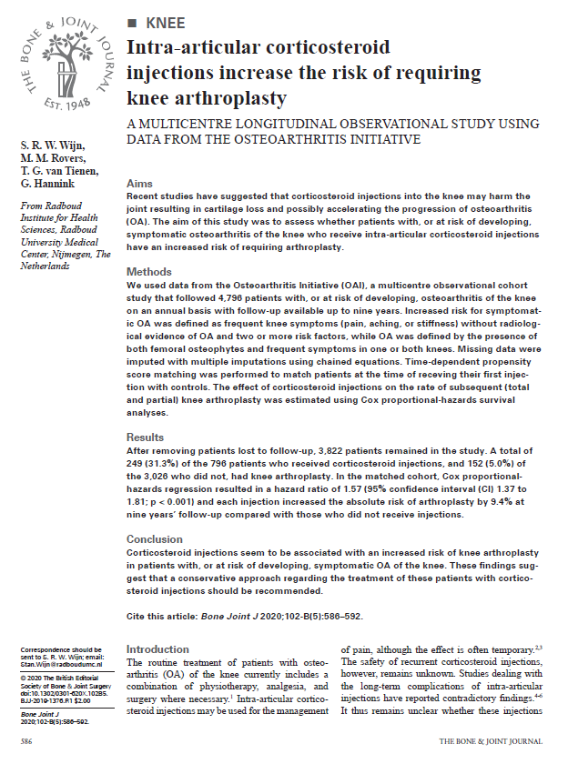
Intra-articular corticosteroid injections increase the risk of requiring knee arthroplasty
Multicenter Observational Cohort Study
Data from Osteoarthritis Institute (OAI)
4,796 patients at risk of OA knee
Followed for 9 years
249/796 (31.3%) of IACS had TKR
152/3026 (5.0%) of remainder had TKR
Each IACS injection increased risk of TKR by 9.4% at 9 years compared with those who did not get IACS
Stan R.W. Wijn et al. Bone Joint J 2020; 102-B(5):586-592

Slide 23
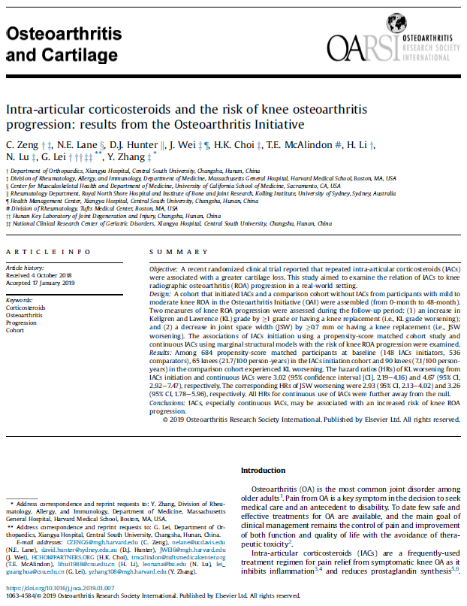
Intra-articular corticosteroids and the risk of knee osteoarthritis progression: results from the Osteoarthritis Initiative
McAlindon et al. reported that repeated intra-articular corticosteroids (IACS) were associated with a greater cartilage loss (JAMA, 2017)
This study aimed to examine the relation of IACS to knee radiographic osteoarthritis (ROA) progression in a real-world setting
The associations of IACS initiation using a propensity-score matched cohort study and continuous IACs using marginal structural models with the risk of knee ROA progression were examined
IACS, especially continuous IACS, may be associated with an increased risk of knee ROA progression.
Zeng C. et al. Osteoarthritis and Cartilage, https://doi.org/10.1016/j.joca.2019.01.007

Slide 24
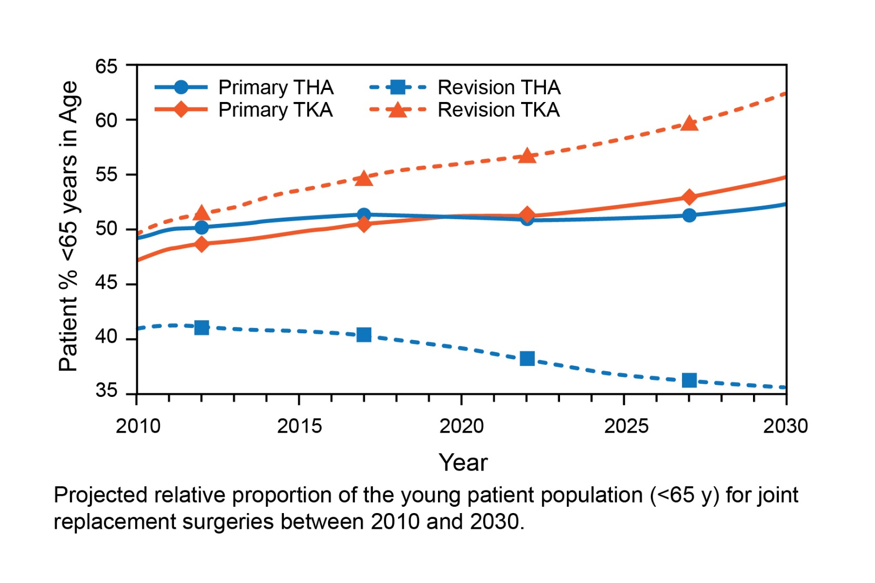
Elective Surgery in The Post COVID-19 World
Globally guidance from major associations agree that elective surgical procedures require postponement to minimize risk of COVID-19 spread
Need to consider non-operative management
Already many patients are declining elective surgery
Knee Arthroplasty is one routine surgical procedure that is likely to be delayed by 48-72 months
Phillips M, et al Accepted for publication May 2020 Therapeutic Advances in Musculoskeletal Disease
A growing percentage of the younger patient population is projected to undergo primary and revision knee joint replacement.
Kurtz SM, et al. Clin Orthop Relat Res. 2009;467:2606-2612.

Slide 25
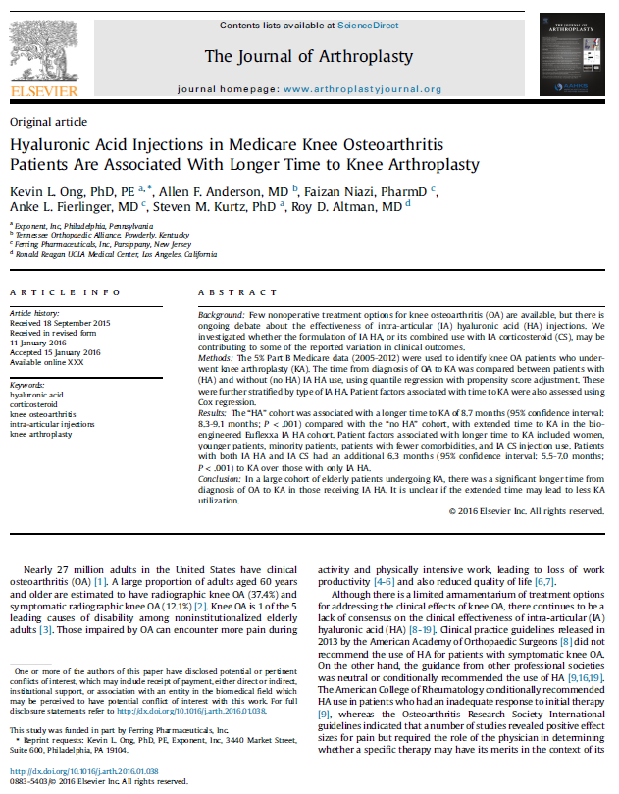
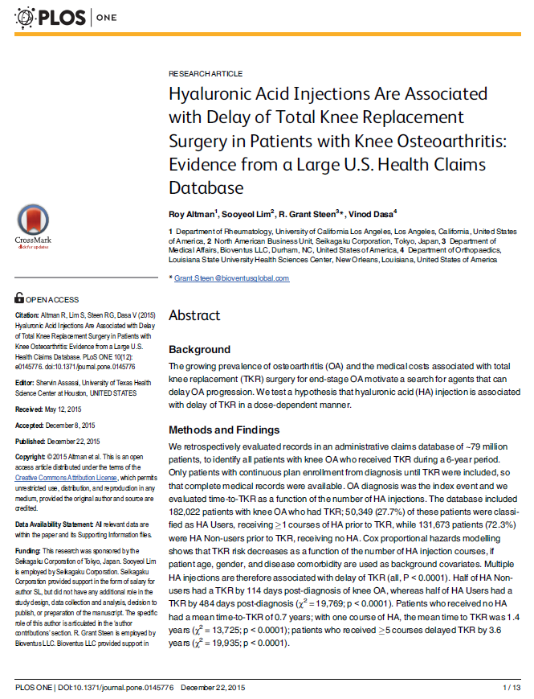
Delaying the need for TKA
In has been reported in several large cohorts of patients undergoing Knee Arthroplasty (TKA) that there was a significant longer time¹ and dose-dependent increase in time to TKA in those receiving IAHA²
Ong K, et al. The Journal of Arthroplasty10.1016/j.arth.2016.01.038
Altman R et al. PloS one10.1371/journal.pone.0145776

Slide 26
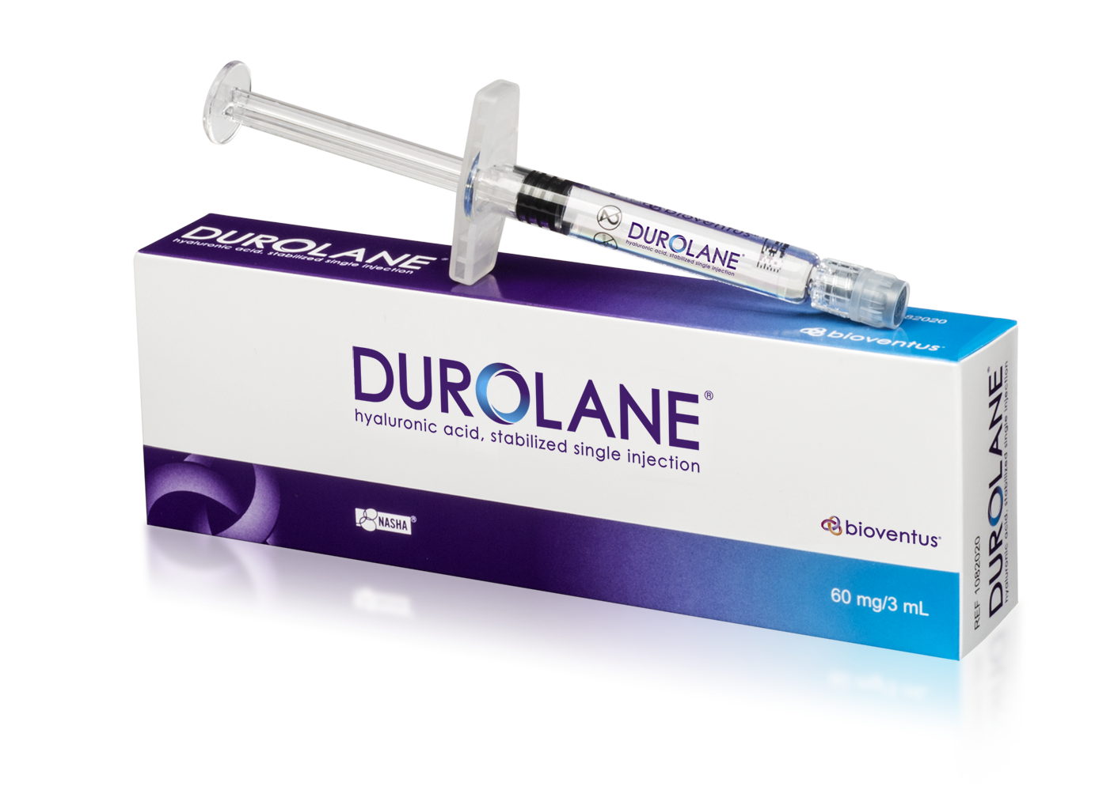
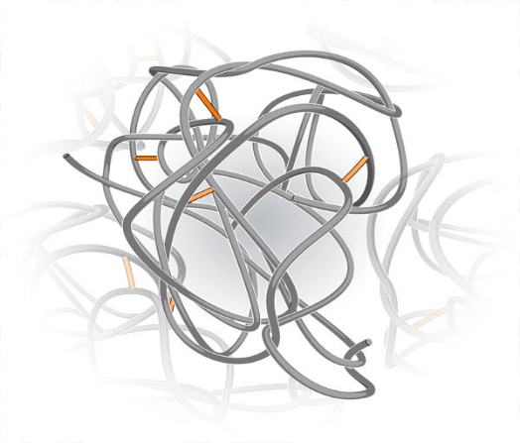
The DUROLANE Difference
Entangled network
of HA chains
Covalent bond
DUROLANE is a clear, transparent, viscous gel of highly purified, stabilized, non-animal-derived sodium hyaluronate (20 mg/mL.) that is biosynthesized using bacterial fermentation.
NASHA® technology is used to stabilize naturally entangled hyaluronic acid (HA) chains to produce a viscous gel.

Slide 27
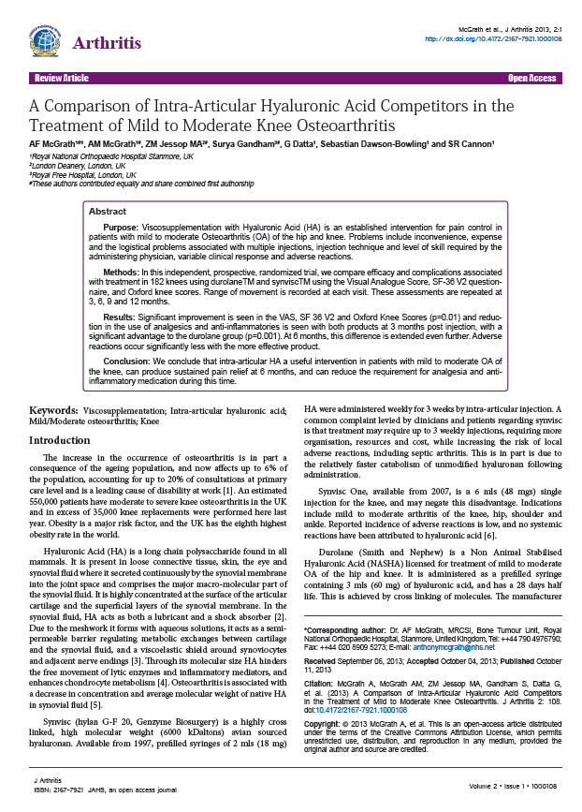
Longer residence time translates into extended pain relief –clinical evidence vs Synvisc
Independent, prospective randomized trial comparing Synvisc-One® (hylan G-F 20). vs DUROLANE.
182 patients
KL 2 and KL 3 (Kellegren-Lawrence radiographic score).
Assessments performed at 3, 6, & 9 months post-injection.
Patients with other symptomatic joints excluded.

Slide 28
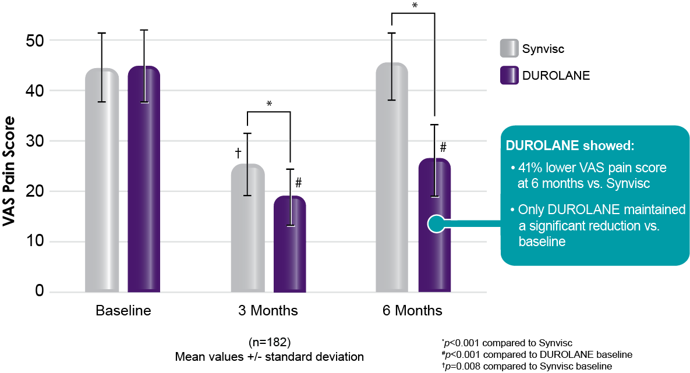
Greater reduction in knee pain vs. Synvisc-One

Slide 29
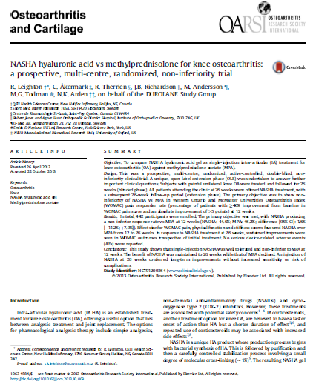
NASHA hyaluronic acid vs methylprednisolone for knee OA
Prospective, randomized, double blind, active-controlled Investigator initiated Level 1 study.
Mild to moderate knee osteoarthritis.
Non-inferiority to methylprednisolone acetate (MPA).
26 week, blinded phase + 6-month open label extension phase
442 patients across 3 countries.
Age average 35-80 years.
Investigators conducted the an open-label extension in 342 patients to see if benefits would be replicated and to measure sensitivity to repeat injections.
Leighton R, Akermark C, Therrien R, et al. NASHA hyaluronic acid vs methylprednisolone for knee osteoarthritis: a prospective, multi-center, randomized, non-inferiority trial. Osteoarthritis Cartilage. 2014; 22: 17-25.

Slide 30
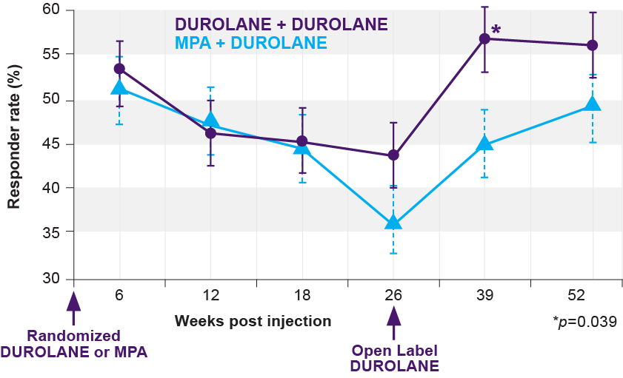
Improved Responder Rates
Non-inferiority was determined at all time points to 26 weeks
Continued increase in responder rates during open label phase
DUROLANE injected patients who did not receive a second injection had benefit out to 12 months (n = 30)
DUROLANE Injection
DUROLANE Injection
DUROLANE + DUROLANE = 162
MPA + DUROLANE = 178
Leighton R, Akermark C, Therrien R, et al. NASHA hyaluronic acid vs methylprednisolone for knee osteoarthritis: a prospective, multi-center, randomized, non-inferiority trial. Osteoarthritis Cartilage. 2014; 22: 17-25.
Notes:
DUROLANE is non inferior to MPA: Repeat injections are safe and effective
This difference continues to be more pronounced as time goes by
A second DUROLANE injection is not only safe, its actually highly efficacious- statistically significant

Slide 31
Summary
In the post COVID-19 Pandemic era should we be reassessing our treatment of people with OA Knee?
Re-evaluate the use of HA in appropriate patients
Reducing the use of chronic analgesics and opiates
Reducing the repeated use of short acting IACS
Delaying the need for TKA
Move the non-surgical treatment of OA away from the surgeon

Slide 32
Peter.Shaw@BioventusGlobal.Com 908-323-3663
Thank You

